Slide 1

Life Expectancies of the World
Team 8:
Daniel Papp
Courtney Toussaint
Aminah Qandeel
Audrey Fermanich

Slide 2
Table of contents
01
02
03
04
Introduction
Data & Delivery
Life Expectancy (WHO) fixed
SQLite powered by Python Flask API
Back End
Visualizations
Interactive dashboard with Plotly
Life Expectancies Over Time & Mortality

Slide 3

Introduction
About the data:
Life expectancy data pulled from a 21 variable dataset
179 countries, from 2000-2015
Source: Kaggle https://www.kaggle.com/datasets/lashagoch/life-expectancy-who-updated?resource=download

Slide 4
Fun Facts About Life Expectancy!
The Japanese live the longest and healthiest lives, on average.
We are living longer: In preindustrial times, we could expect to live just 30 to 40 years. The global average in 2015 was about 72 years old.

Slide 5
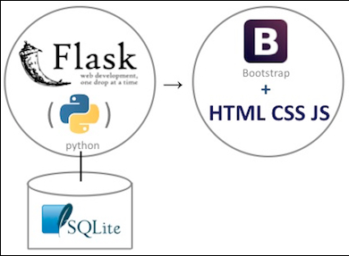
Data & Delivery
About the data:
Life-expectancy related data
Total of 2,846 records from nearly 200 countries between 2000-2015
Database Used: SQLite
Python Flask API, HTML

Slide 6

Back End
New JavaScript library: Chart.js
Interactive dashboard built from Kaggle dataset
Flask API used to retrieve jsonified data for visualizations
Plotly charts

Slide 7
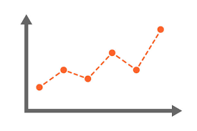
Visualizations
Interactive longitudinal country data:
Life expectancies of the world
Mortality of differing age groups
Static longitudinal average
Comparison chart for average mortality

Slide 8
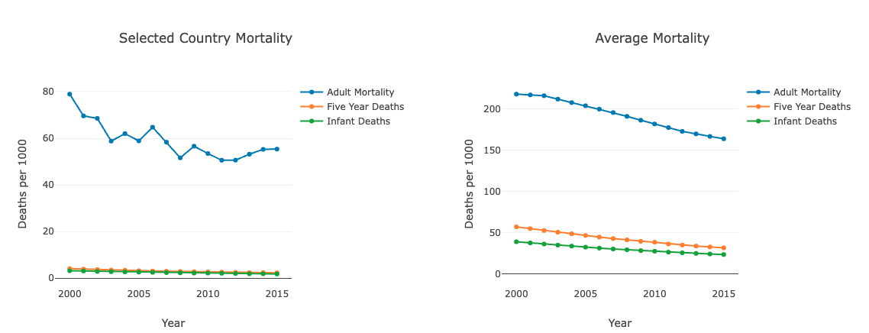
Iceland lowest infant deaths (2015) 1.8

Slide 9
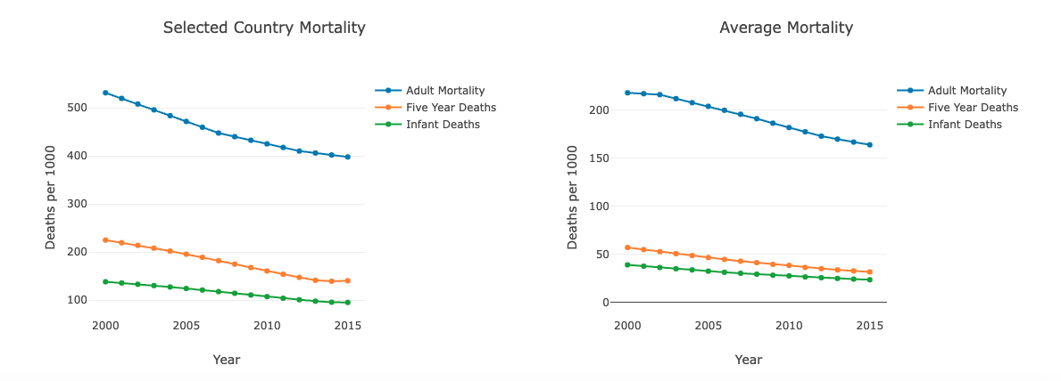
Sierra Leone highest infant death (2000) 138.1

Slide 10
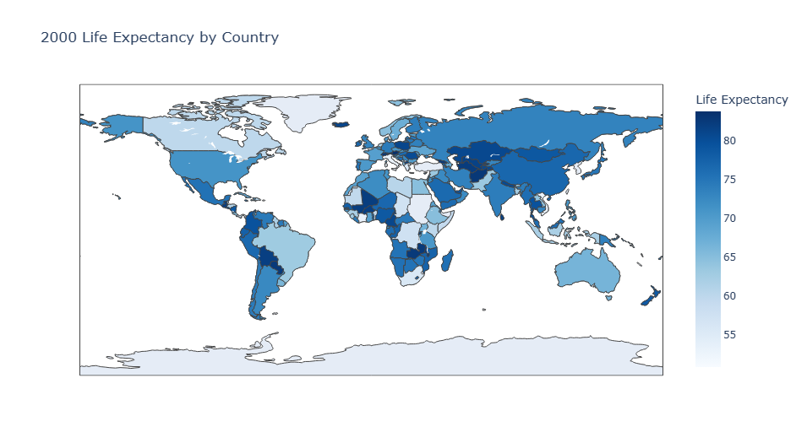
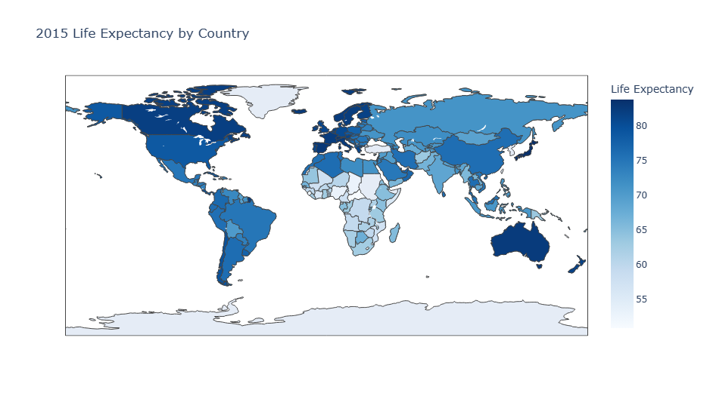
Analysis & Observations

Slide 11
Analysis & Observations
Countries that have experienced wars from 2000-2015 have a steep downturn in their life expectancy slope (ex. Iraq and Syria)
Overall trend of increasing life expectancy over time
Japan highest life expectancy in 2015
83.8
Sierra Leone lowest life expectancy in 2000
39.4

Slide 12
Questions?

